Slide 1
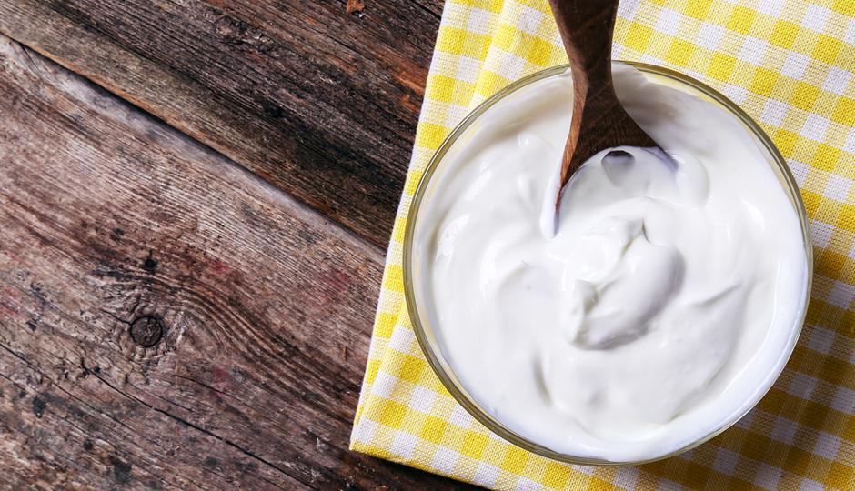
Greek Yogurt Case
Team 15
Wanyu Cheng
Yuying He
Yi Huang
Tianyao Liu
Jing Zou
Feb. 2nd, 2020
Notes:
Always remember the business. How to use cross analysis to address the business needs/ decision framework: increase sales, increase profit margin
That guides data analytics. What data you tend to, which analytics to use
Given this explicit goal, is it appropriate/ meaningful to do these thins

Slide 2
Key Findings & Recommendations
Six existing flavors are more successful in Greek yogurt category than regular one because of higher market share (70.30% vs. 43.53%)
Six existing flavors may not be the best mix. Because it does not comply with customer preferences.
Preference and reach are two distinct decision criterias. Pineapple should be launched as a new flavor to increase reach, which is not consistent as suggested by customer preference survey question (raspberry).
The findings and recommendations may not be reliable, as a result of the inappropriate survey question setting up (question 12).
Notes:
to get started, I want to highlight our key findings and recommendations. Our first key finding is that ; however, these six existing flavors may… according to the customers preferences drawn from survey data. Our recommendation is to launch pineapple as new flavor so as to increase product reach. while this is not consistent as …… this is because preference and reach are two different decision criterias.
it is also worthwhile to point out that the inappropriate survey question setting up might weaken the credibility of our findings as recommendations. In question 12, respondents are asked to organize all 23 flavors into how often they would eat each one, the design of which is not convenient for respondents to give real and accurate answers.

Slide 3
Decision-Oriented Analysis Methodology
Analytics Needs and Goals
Market Sales Data:
market segment shares
using descriptive analysis
Decision Criteria:
Which flavors get highest reach
Consumer Survey Data :
consumer preferences
using descriptive and predictive analysis (TURF)
Notes:
next, I’d like to introduce our analysis methodology. our analytics need is to provide recommendations about which new yogurt flavor to launch. and our analysis goals include control and measurement goals. we also have figured out that our decision criteria is which flavor sets will achieve highest reach. considering all above, we analyzed data from two aspects. one is about market sales data and we measure market segment shares using ; the other perspective is from consumer survey data and we evaluate consumer preferences through descriptive and TURF predictive analysis.

Slide 4
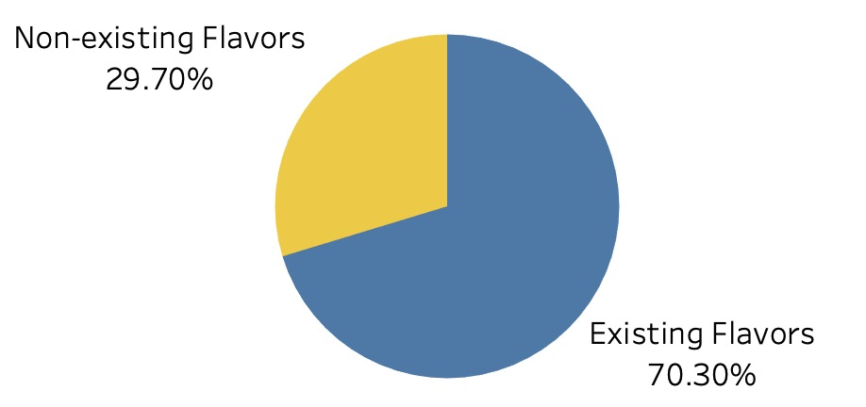
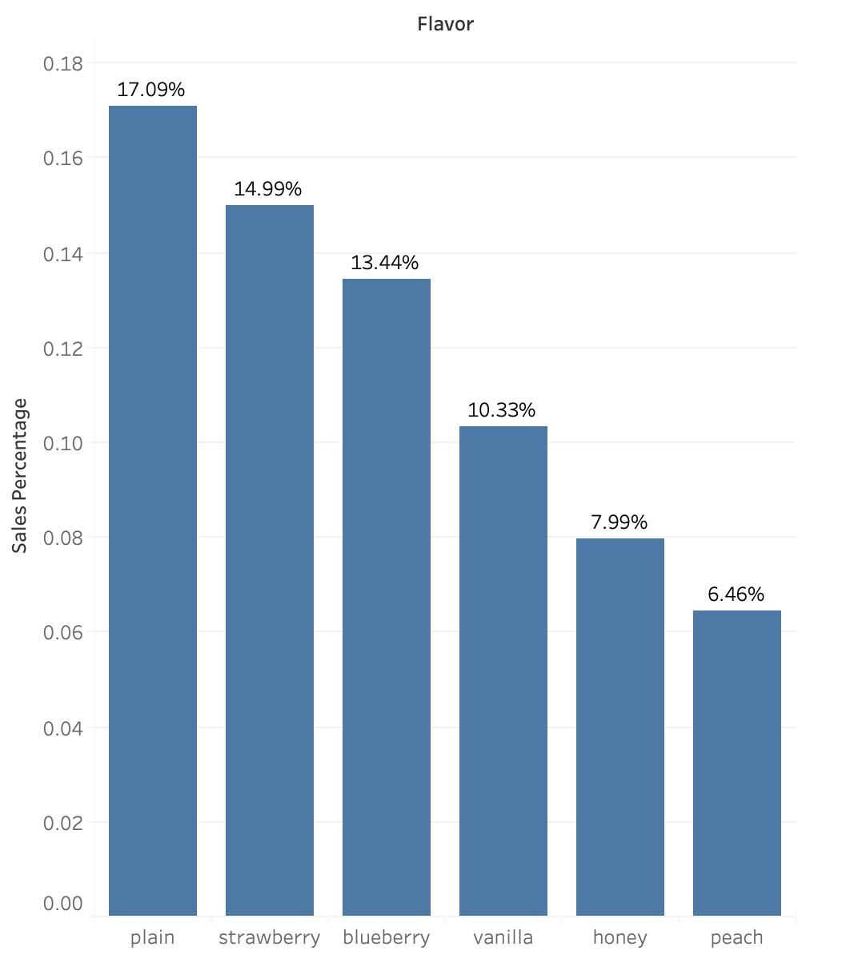
Market Share of Existing Flavors - Greek Segment
70.30% - Percentage of sales of existing flavors in Greek category represents potential for new flavors
Three Top-Selling Flavors: Plain - 17.09%, Strawberry - 14.99%, and Blueberry - 13.44%
Least Welcomed Flavor: Peach - 6.46%
Notes:
Wanyu
First, we used descriptive method to generate insights from sales percentage, market share numbers
The bar chart on the right shows further drill-down of the weights of sales of the six existing flavors
We found out that three top selling flavors are...

Slide 5
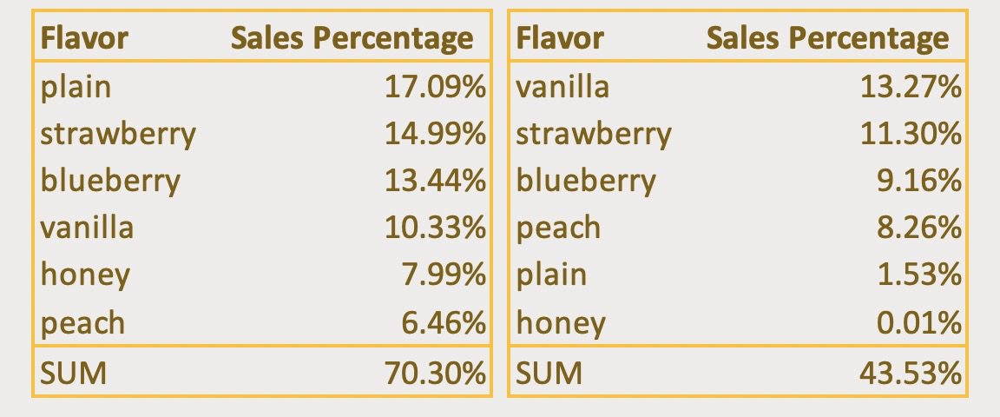
Market Share of Existing Flavors - Whole Segment
GREEK
REGULAR
Six existing flavors are more successful in Greek yogurt category than regular because of higher market share (70.30% vs. 43.53%)
Flavors ranking are different in Greek and regular segment (plain - 1 in Greek vs. 5 in regular; vanilla - 4 in Greek vs. 1 in regular). This indicates that firms should use different flavor mix for different market segments.
Notes:
plain/ vanilla: big difference
Honey: not a well performing flavor in both categories
Yuying
Thanks Wanyu, After discussing market share in Greek segment, we would also like to explore what is the market share of whole segment, which can show people’s preference in different segment.

Slide 6
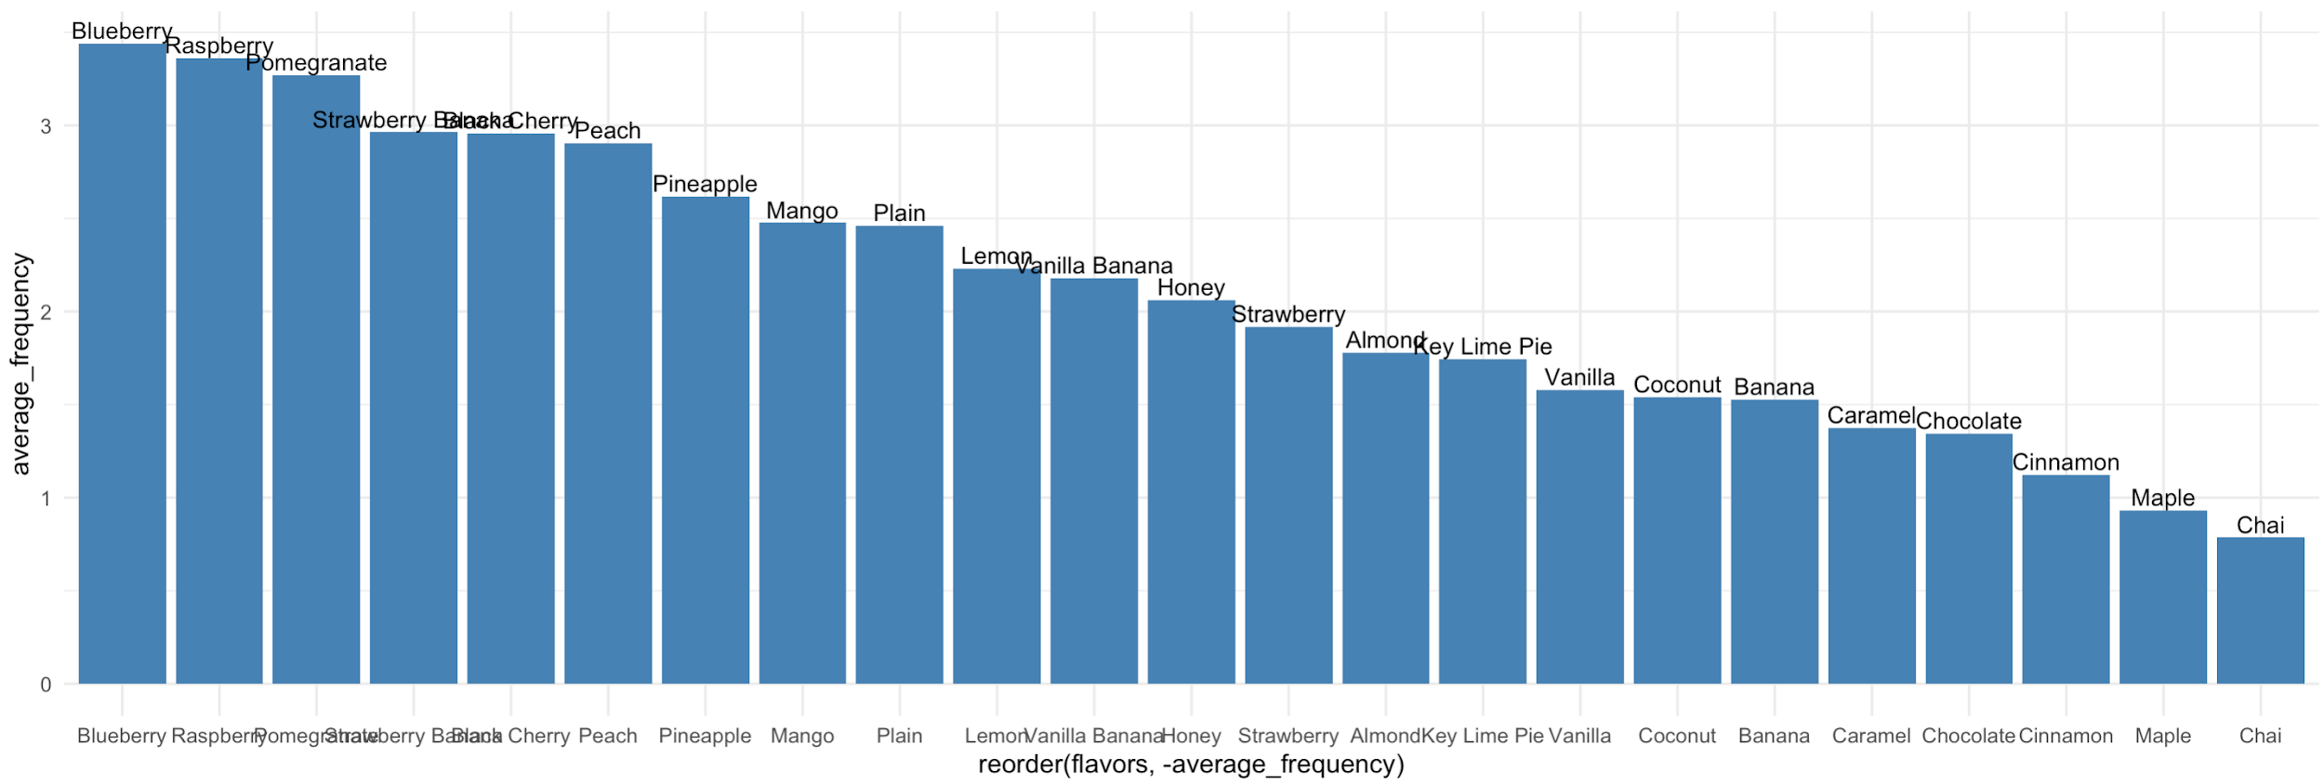
Survey Respondents’ Preferences for Greek Yogurt
Data cleaning:
- Drop rows with NAs to improve further accuracy.
- Weight regular, occasionally and never as frequencies 5, 2, 0
Finding:
- Top 6 preferred flavors are blueberry, raspberry, pomegranate, strawberry banana, black cherry and peach.
- Only blueberry and peach are among existing flavors.
1
2
Calculate sum of each column and divided by nrow() to estimate per person average
3
Use ggplot() to plot the sorted per person consumptions
Notes:
YH: To measure respondents’ preferences for greek yogurt, we cleaned the survey response data first. The observations with NAs were dropped and only completed survey responses were kept. Actually at first we thought about taking NAs as consumers choosing not to buy this flavour and assign 0 to them. However, according to the question design, NA in the result only indicates that a respondent did not make a decision on a particular flavor, or even maybe the respondent did not take all flavors listed into consideration which means the whole response is biased, and we cannot assume the meaning of NAs subjectively. NAs cannot provide any information. Therefore, We think the safest way to treat NAs is dropping the whole response.
Next, we assigned 5 to option ‘buying regularly’, 2 to option ‘occasionally’, and 0 to ‘Never’, as the weight for each purchasing frequency. Finally we added up the total scores a flavor got, and calculate the mean as average buying frequency for each flavor. Top 6 preferred flavors are blueberry, raspberry, pomegranate, strawberry banana, black cherry and peach, which consumers will mostly choose to buy, and among them only blueberry and peach are in existing flavors. This means existing flavors may not be the best mix. Because it does not comply with customer preferences.

Slide 7
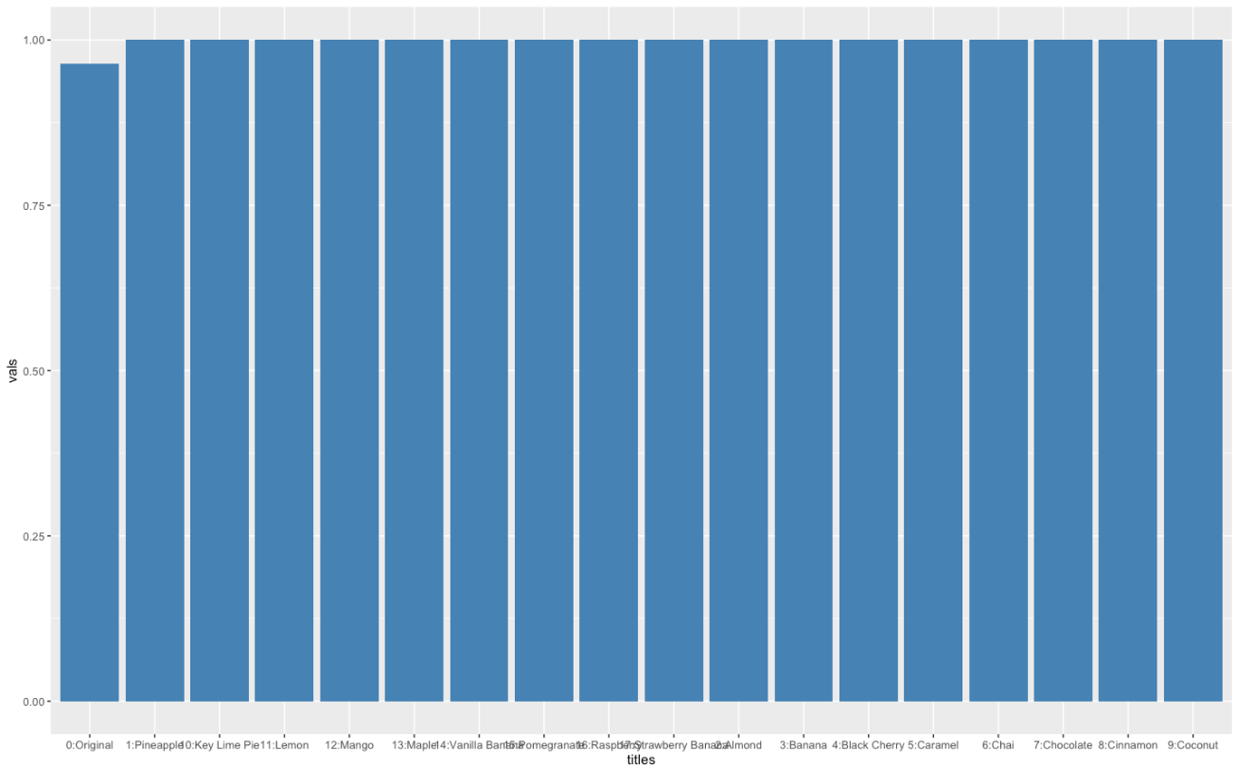
Flavors to be Launched in Future Prediction
Transform the original frequency data into dummy variables (treat regularly and occasionally as ‘would buy’ and assign it as 1; treat never as ‘would not buy’ and assign it as 0.)
Finding:
- The private label should launch pineapple as the new flavor, which leads to biggest incremental reach
Notes:
After calculating the average purchasing frequency of each flavor, we then turned to TURF analysis the determine next flavor to launch for the private label based on aggregated reach together with the existing market.
Firstly, we convert the previous frequency table to choice data with only binary variables. Here, 0 represents not buying and 1 represent buy. We convert occasionally buy and regularly buy to 1, and never buy to 0. //From the turf ggplot and the data behind it we could see that with the 6 flavors as the status quo, the private label already reached 96% of the total market. To maximize the incremental reach, the next flavor launched should be pineapple as it appears exactly next the status quo. //Also, from the bars we could see the reach would not increase much as we further launch other flavors after pineapple. Probably this is because we will be already had enough flavor mix to reach the whole potential market by launching seven flavors.
So in our work we dealt with sales data of retailers and consumer survey data to calculate percentage of sales, average purchasing frequencies, and aggregated reach using different analytical tools to make a thorough decision. We hope we can cooperate together and with our data, you could grow your brand more successfully.

Slide 8
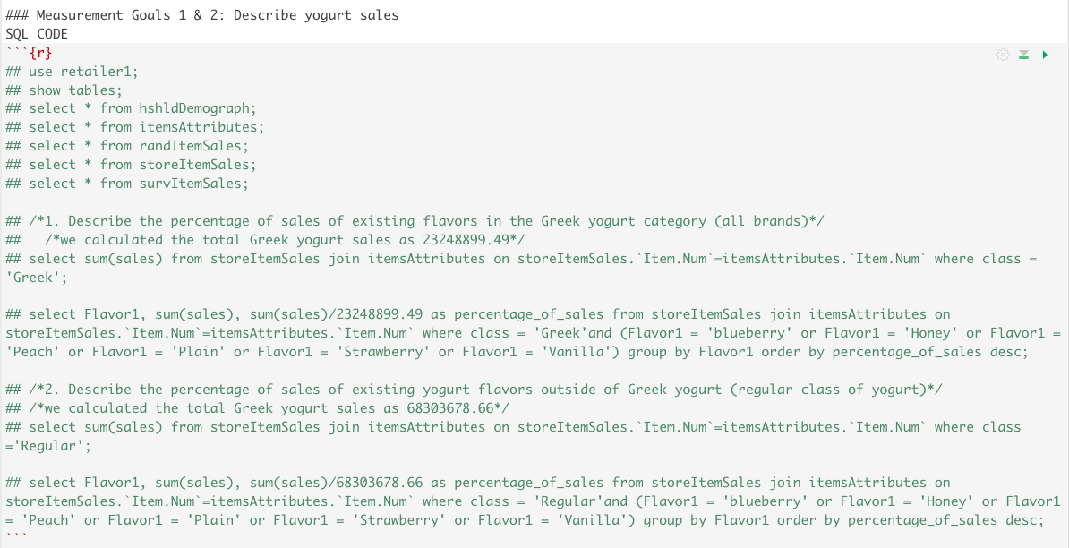
Appendix - OUTPUT FOR SLIDE 4 & 5

Slide 9
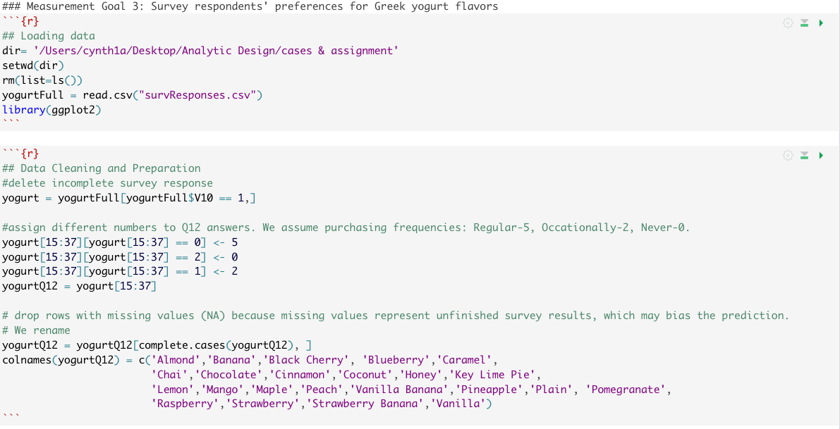
Appendix - OUTPUT FOR SLIDE 6

Slide 10
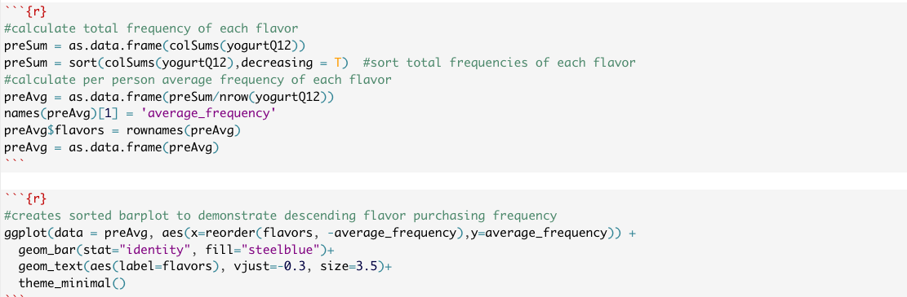
Appendix - OUTPUT FOR SLIDE 6 CONTINUED

Slide 11
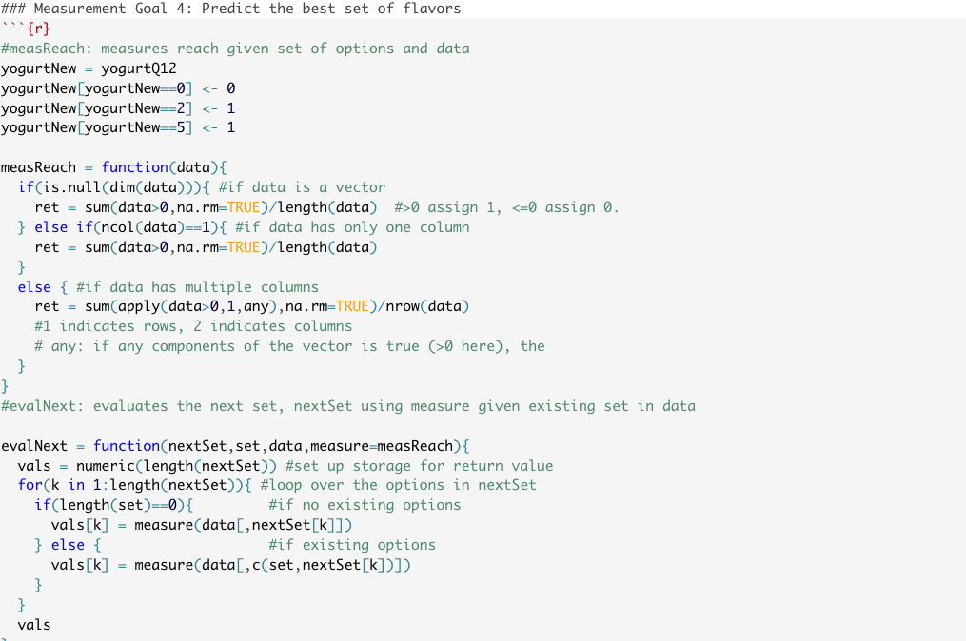
Appendix - OUTPUT FOR SLIDE 7

Slide 12
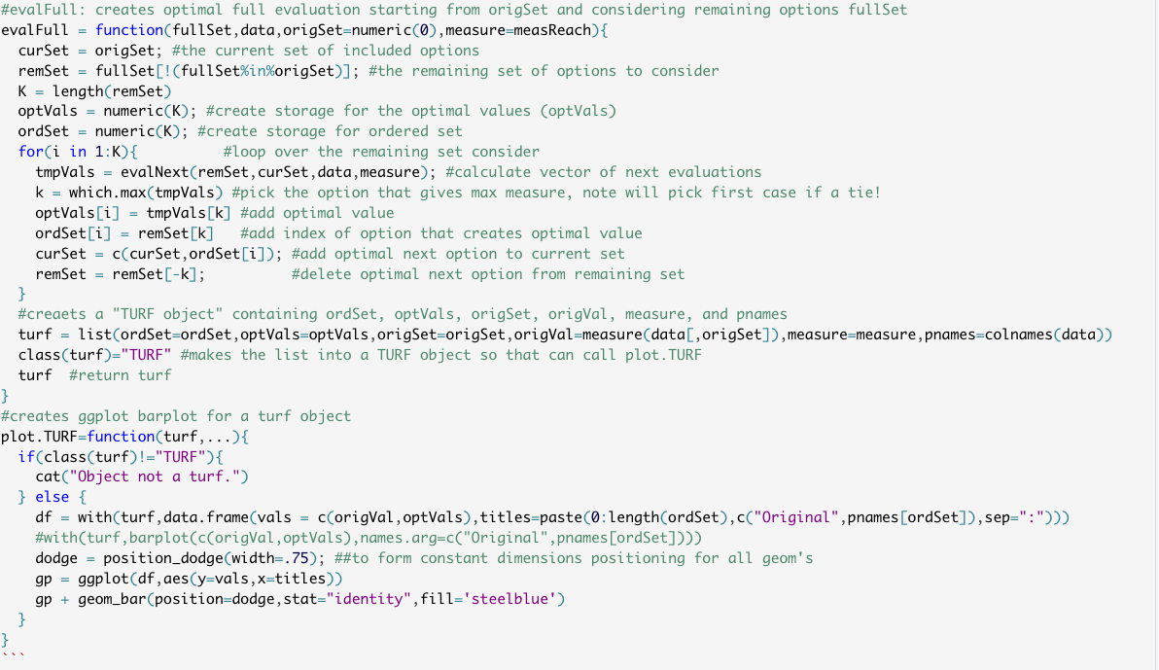
Appendix - OUTPUT FOR SLIDE 7 CONTINUED

